Slide 1
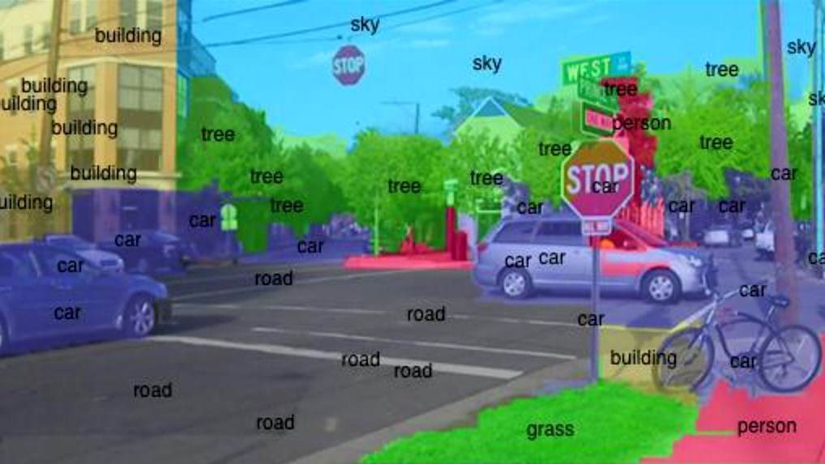

Intro to Computer Vision
Yoni Chechik
www.AIisMath.com

Slide 2
contents
Course details
What is computer vision (CV)?
Course outline
Intro to Python

Slide 3
References
Lectures Based on the book: Computer Vision: Algorithms and Applications, 2010, Richard Szeliski (http://szeliski.org/Book/)

Slide 4
Course objectives
The student will know and understand key algorithms in computer vision.
The student will be familiar with the algorithmic R&D process, with an emphasis on understanding the advantages and disadvantages of various algorithms and building an algorithmic system that concentrates on computer vision and image processing.
The student will be able to solve algorithmic problems with computer vision both at theoretical and practical level (in Python using NumPy, Matplotlib, OpenCV & TensorFlow packages).

Slide 5
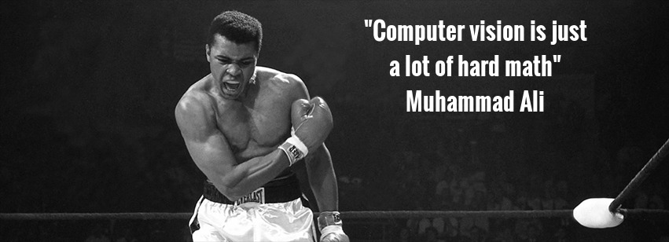
Prerequisites
No prior knowledge in signal/image processing is assumed.
Heavy use in algebra and calculus- mathematical maturity is assumed.

Slide 6
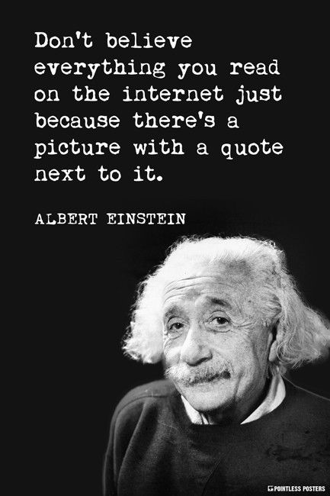
contents
Course details
What is computer vision (CV)?
Course outline
Intro to Python

Slide 7
What is CV?
Computer vision is an interdisciplinary scientific field that deals with how computers can be made to gain high-level understanding from digital images or videos. [Wikipedia]
Image processing is an umbrella term for many functions that analyze images or convert one representation of an image into another.

Slide 8
What is CV?
Output Input | Data | Image
Data | Signal processing | Computer graphics
Image | Computer vision | Image processing
Machine learning
Computer vision
Signal processing
Image processing
Computer graphics

Slide 9
Why CV?
IT’s
f***ing
cool

Slide 10
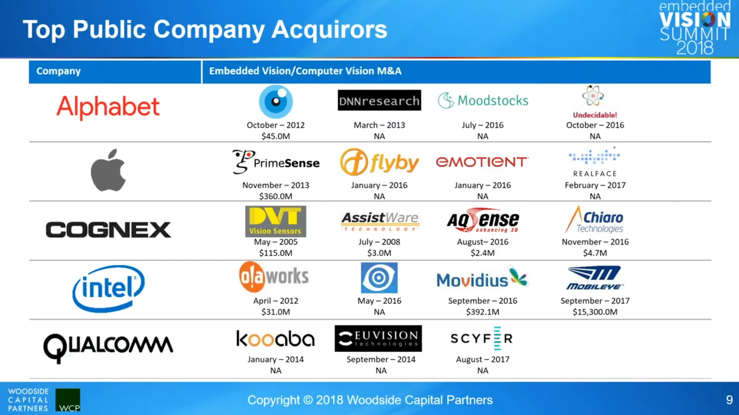
Why CV?

Slide 11


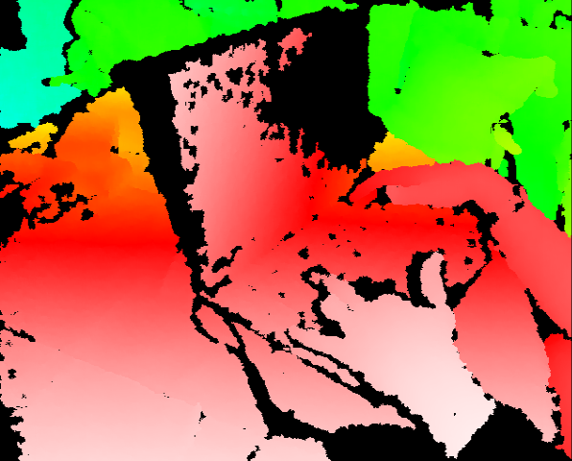
PrimeSense == Kinect
Kinect for Xbox 360: 3D scanner system using Light Coding approach for 3D reconstruction.
KinectFusion [Newcombe et al., 2011] : https://www.youtube.com/watch?v=KOUSSlKUJ-A

Slide 12
Why CV?

Slide 13
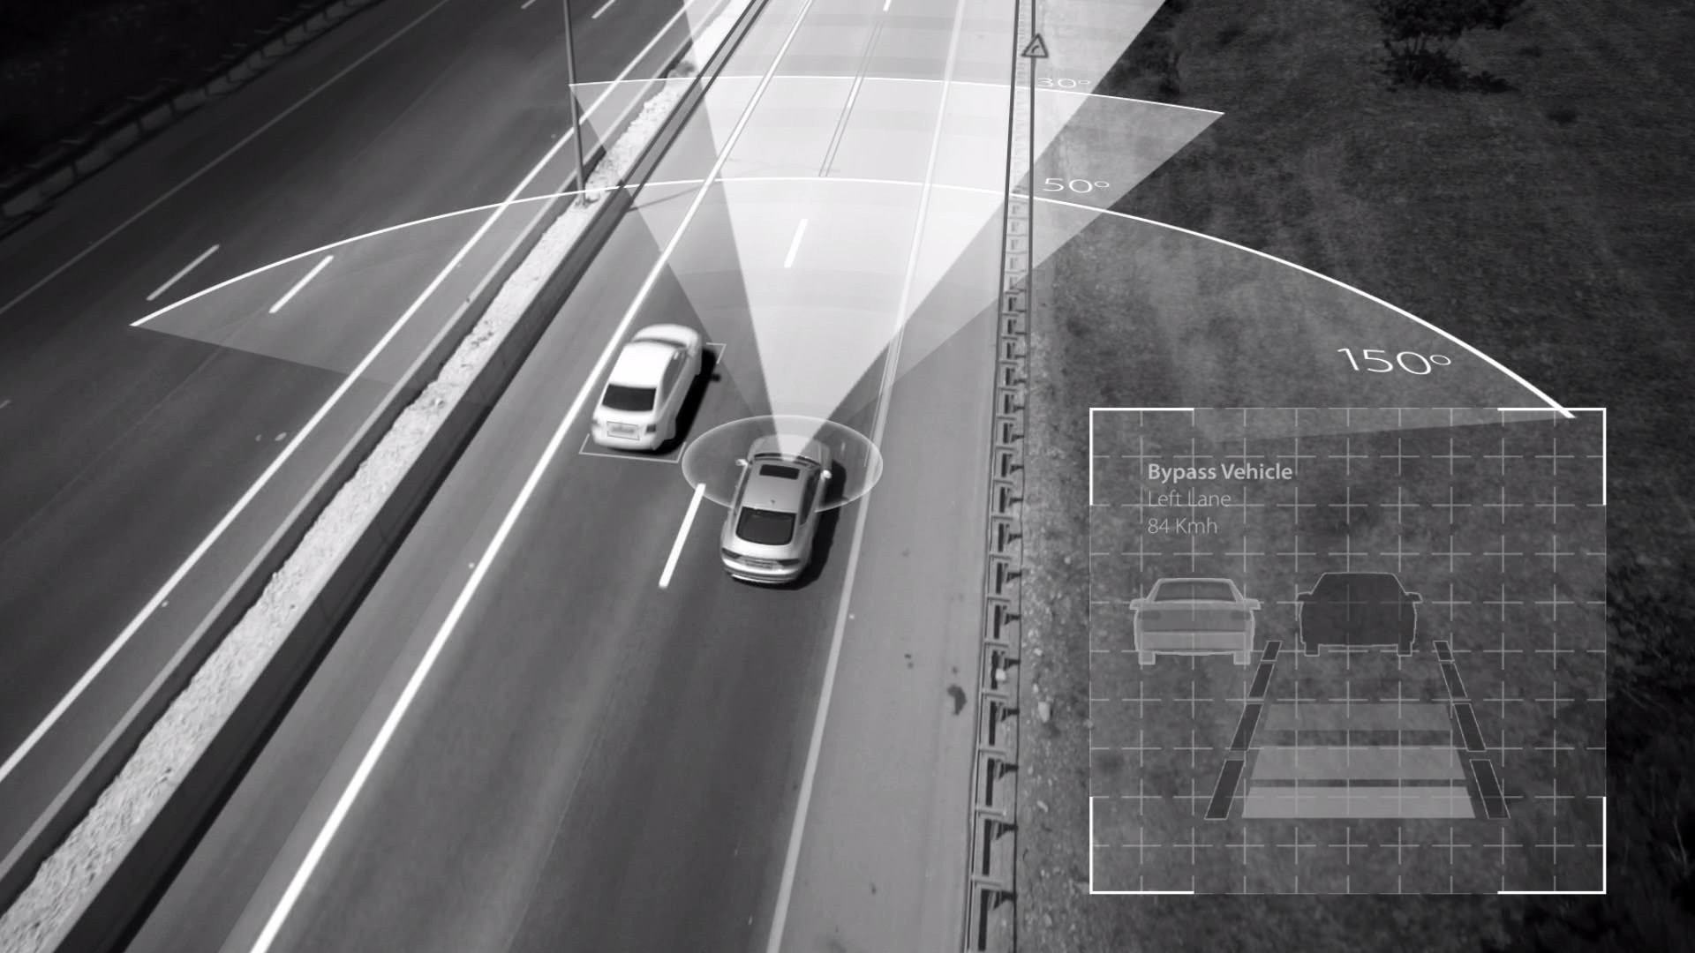
Mobileye
Mobileye is an Israeli subsidiary of Intel corporation that develops vision-based advanced driver-assistance systems (ADAS) providing warnings for collision prevention and mitigation. [Wikipedia]
https://www.youtube.com/watch?v=JDUb6CurYJM
https://www.youtube.com/watch?v=fKXztwtXaGo (Tesla- cooler!)

Slide 14
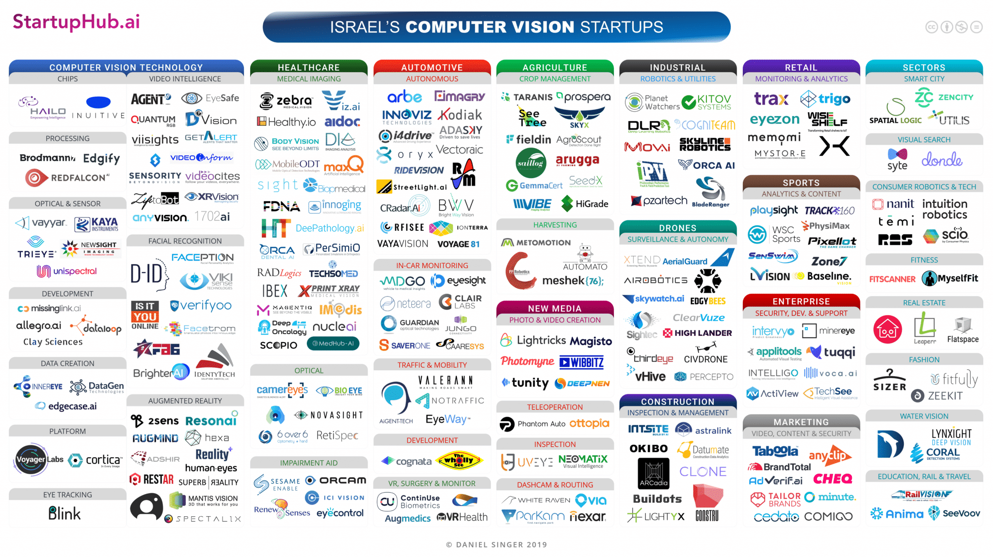
Why CV?

Slide 15

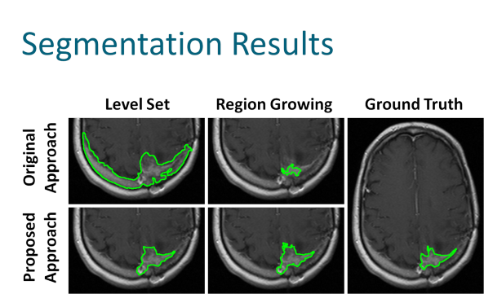
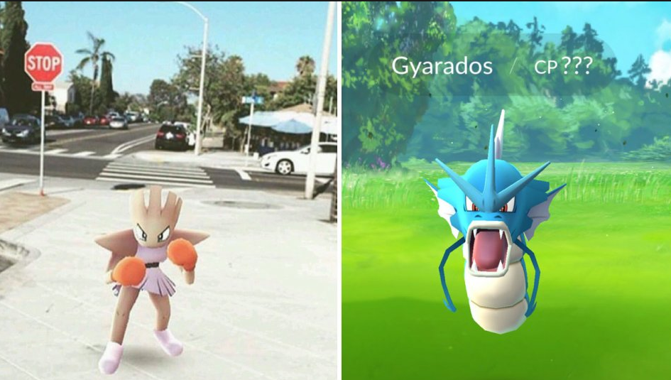
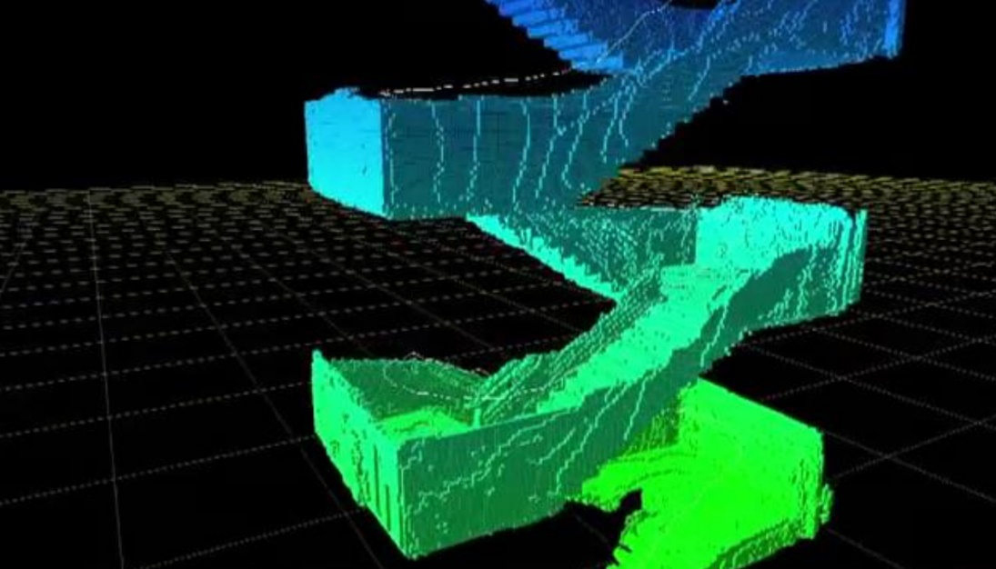
More CV related topics
Virtual/augmented reality
navigation
Gaming
medicine
And much more…

Slide 16
contents
Course details
What is computer vision (CV)?
Course outline
Intro to Python

Slide 17
Course outline
# | subject
1 | Introduction to CV + Python: NumPy, Matplotlib, OpenCV
2 | Image processing recap: convolutions, LPF, HPF, morphology, connected components, gamma correction, decimation, interpolation.
3 | Edge detection: gradient (roberts, prewitt, sobel), Laplacian, DoG (derivative of Gaussian), canny edge detector.
4 | Curve fitting: least squares, total least squares, RANSAC, Hough transform.
5 | Image formation: BRDF, pinhole camera, digital camera
6 | Geometric transformation: 2d->2d, 3d->3d, 3d->2d (perspective and homographic projection)
7 | Camera calibration: extrinsic, intrinsic, radial distortion.
8 | Stereo vision: dual camera rectification, triangulation.
9 | Features: feature detection, feature description, matching, SIFT, panoramas.
10 | Stereo: SfM, Epipolar geometry, rectification, triangulation, matching.
11 | Neural networks 1: intro, perceptron, dense layers, MNIST.
12 | Neural Networks 2: CNN, back-propagation, tensorflow.

Slide 18
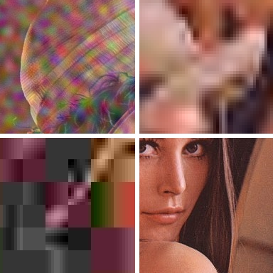
Image processing
Read more about Lenna – the standard test image: https://en.wikipedia.org/wiki/Lenna

Slide 19
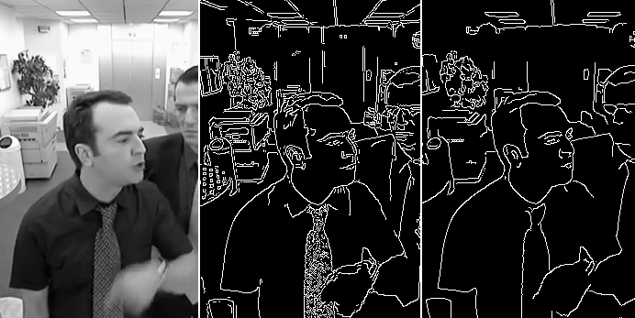
Edge Detection
https://www.youtube.com/watch?v=hQ-bpfdWQh8
https://pinetools.com/image-edge-detection

Slide 20

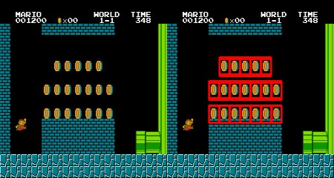
Shape detection

Slide 21
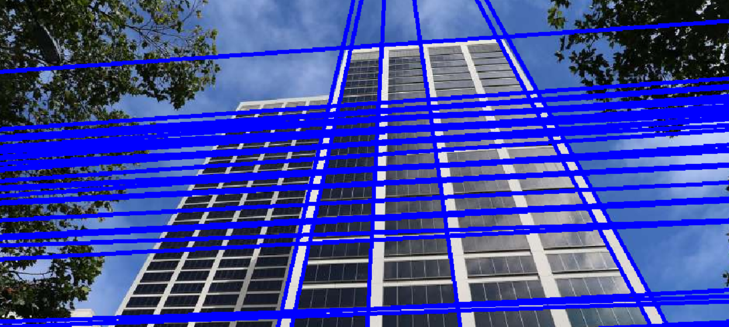
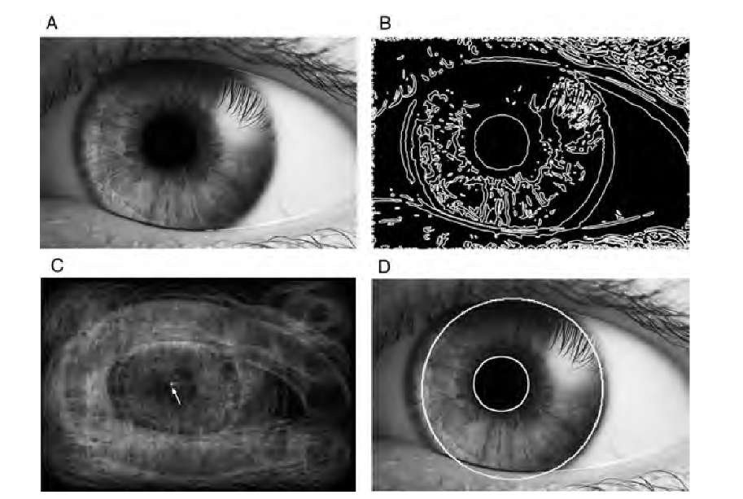
Curve fitting & Hough transform

Slide 22
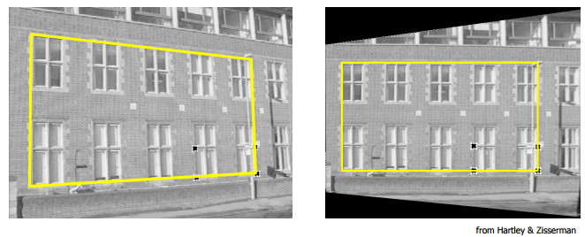
Digital cameras
Image formation: https://www.youtube.com/watch?v=dY0K65eXhkA
2D & 3D transformation.

Slide 23
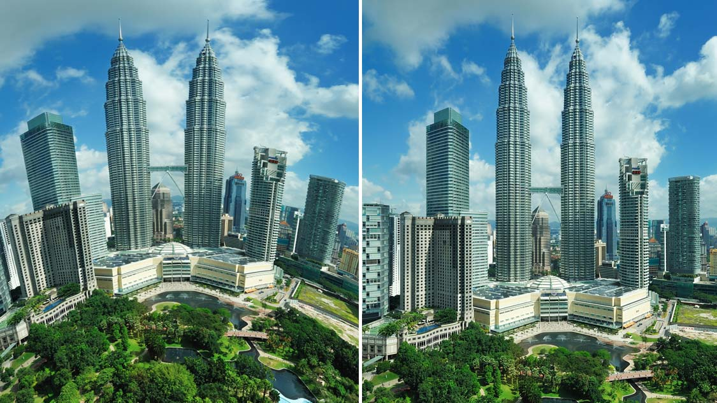
Image calibration
Fisheye correction from go-pro for example

Slide 24
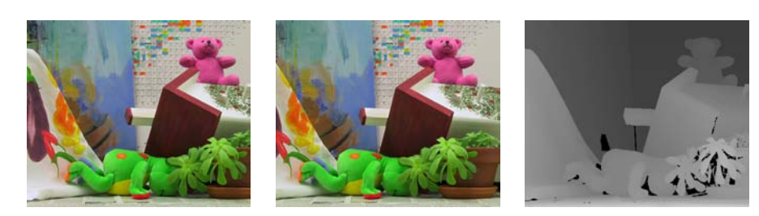
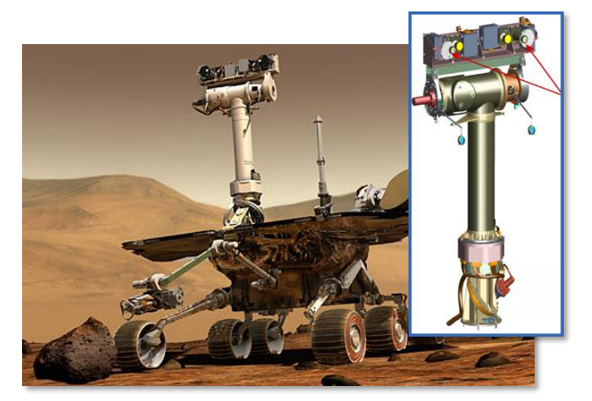
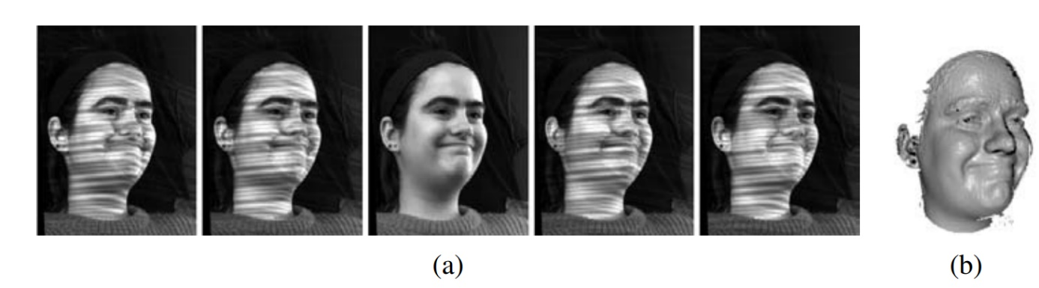
Stereo & 3d cameras
https://www.youtube.com/watch?v=PySBQ8Q_R8k

Slide 25
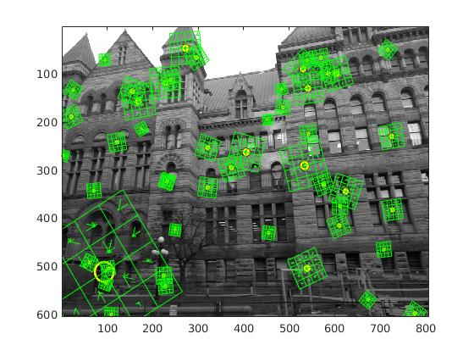
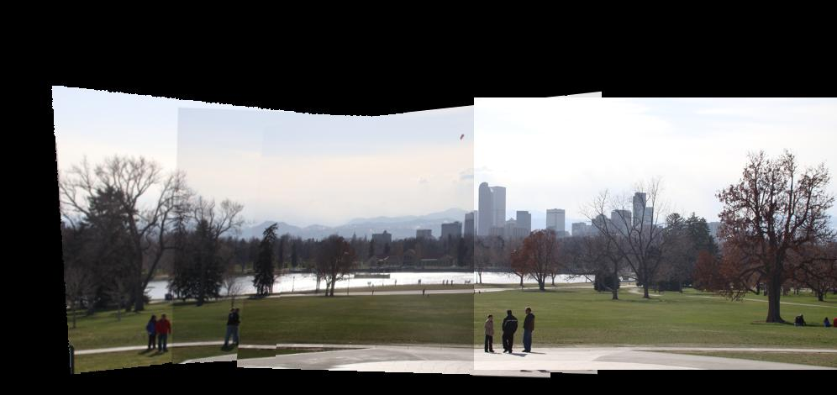
Features
Extract interesting points from image for later recognition, stitching, learning and more.
http://www.in2white.com/
Notes:
panoramas

Slide 26
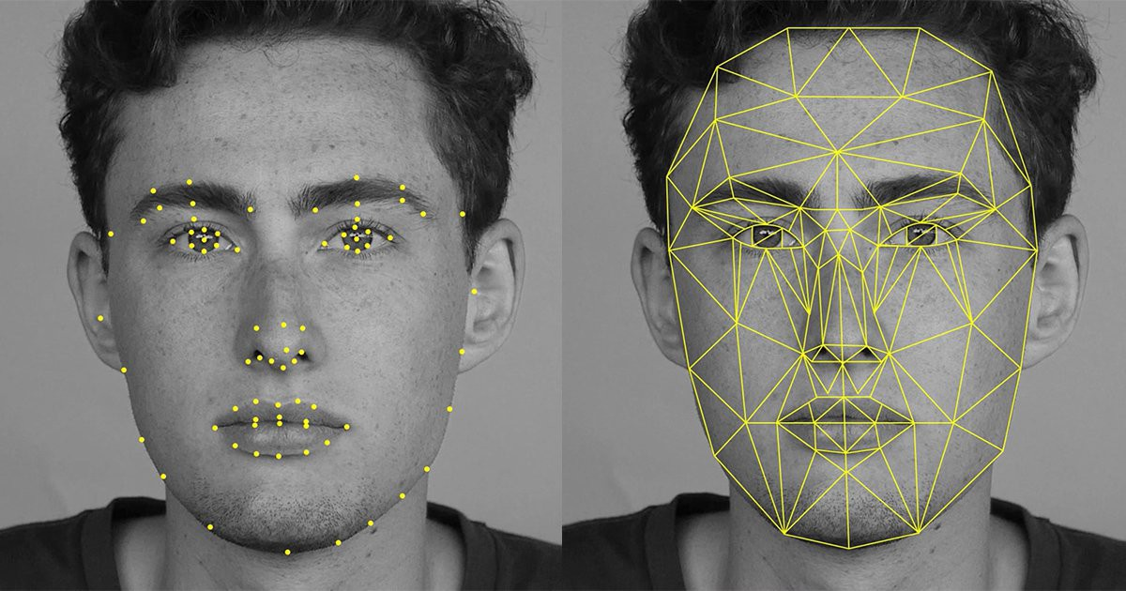
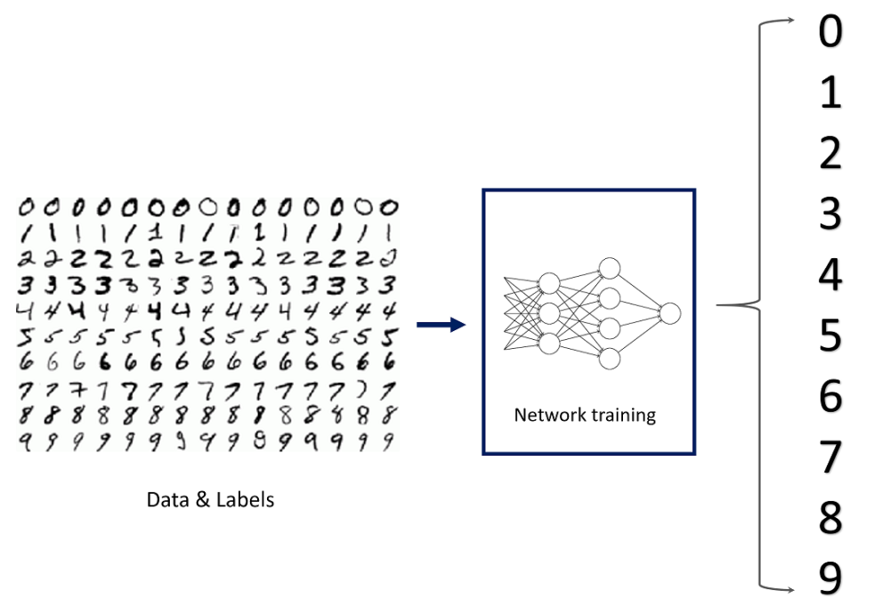
Neural networks
https://deepdreamgenerator.com/generator
https://quickdraw.withgoogle.com

Slide 27
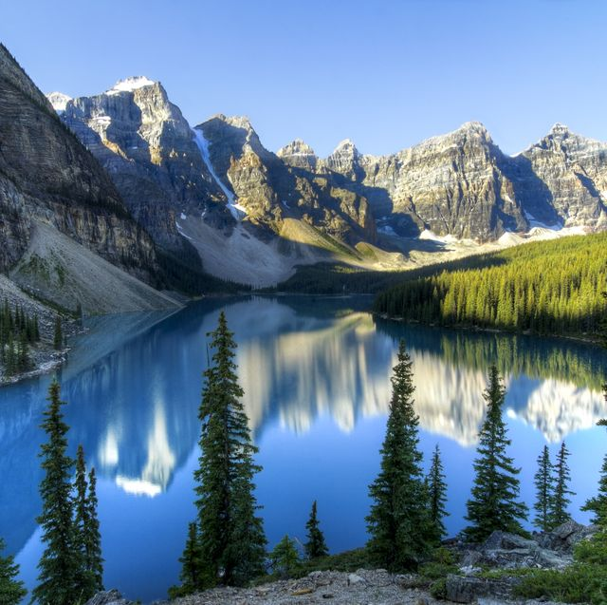
Dream generator- style transfer

Slide 28
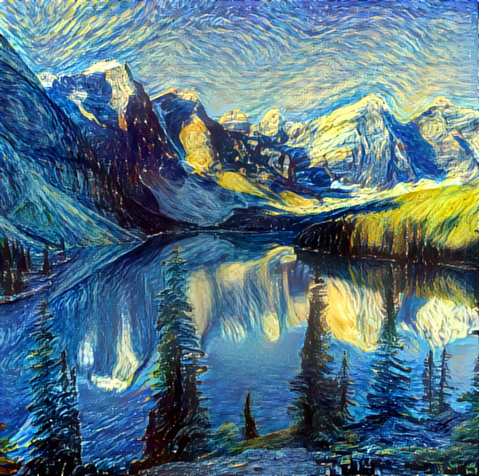
Dream generator- style transfer

Slide 29
And some more AI stuff
Deep fake
https://www.youtube.com/watch?v=cQ54GDm1eL0
https://www.youtube.com/watch?v=-QvIX3cY4lc
Nvidia GauGAN
https://www.youtube.com/watch?v=p5U4NgVGAwg
http://nvidia-research-mingyuliu.com/gaugan

Slide 30
contents
Course details
What is computer vision (CV)?
Course outline
Intro to Python

